Slide 1

ỦY BAN NHÂN DÂN THÀNH PHỐ HỒ CHÍ MINH
TRƯỜNG CAO ĐẲNG LÝ TỰ TRỌNG TP. HỒ CHÍ MINH
Bậc đào tạo: CAO ĐẲNG CHUYÊN NGHIỆP
Tên giảng viên: ĐINH TRẦN PHƯƠNG THẢO

Slide 2
AMERICAN ENGLISH FILE
UNIT 3: PLANS AND DREAMS

Slide 3
Relative Clause
The boy is my brother.
Which boy are you talking about?
He is wearing a cap.
Oh I see! The boy who is wearing a cap is your brother.

Slide 4
Relative Clause
The boy who is wearing a cap is my brother.
Are you talking about me?
What does it refer to?
The relative pronouns (which, who, whom or that) refer to the noun (or noun phrase) before it.

Slide 5
Relative Clause
People → who (subject), whom (object)
Things → which
We can use ‘that’ instead of ‘who’, ‘whom’ and ‘which’.

Slide 6
Relative Clause
The lady who (that) talked to me last night was Jenny.
  → Jenny talked to me last night.
  (Sub.)
The lady whom (that) talked to last night was Jenny.
  → I talked to Jenny last night.
  (Obj.)
I

Slide 7
Relative Clause
Which relative pronoun should we use?
The girl studies French doesn’t speak Cantonese.
Do you know the man I talked to?
It’s a book will interest children of all ages.
who/that
whom/that
which/that

Slide 8
Relative Clause
The students are smart.
They are learning relative clause.
The students
who are learning relative clause
are smart.
‘who’ is used instead of ‘they’

Slide 9
Relative Clause
Try to connect the sentences by using relative clause.
e.g. The girls annoyed me. They talked too much.
The girls who talked too much annoyed me.

Slide 10
Relative Clause
The man told me to come back today. He left yesterday.
The cute boy is the owner’s son. He works in the shop.
The ladder began to slip. I was standing on it.
→ The man who left yesterday told me to come back today.
→ The cute boy who works in the shop is the owner’s son.
→ The ladder which I was standing on began to slip. /
The ladder on which I was standing began to slip. (more formal)
The ladder which I was standing on began to slip. /
The ladder on which I was standing began to slip. (more formal)

Slide 11
Relative Clause
Remember! The pronoun refers to the same thing as the relative pronoun does should be omitted.
e.g. The girl is my sister. You saw her yesterday.
A: The girl whom you saw her yesterday is my sister.
B: The girl whom you saw yesterday is my sister.

Slide 12
RELATIVE CLAUSES
GAME
Choose the right option.

Slide 13
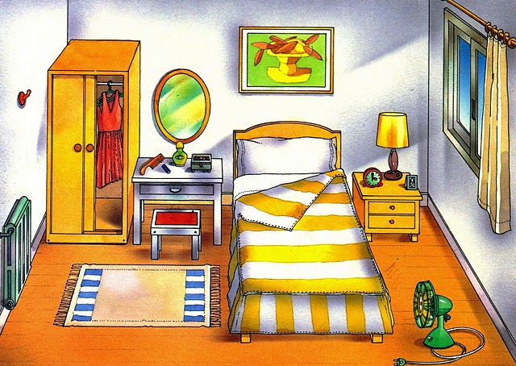


The children …are playing in the bedroom are my best friends..
GREAT
which
who
whose

Slide 14
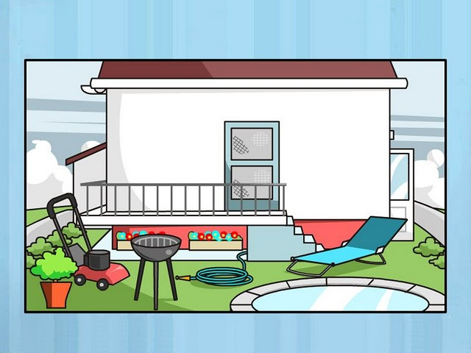


The plane… the boy is playing with was expensive.
GREAT
which
who
whose

Slide 15
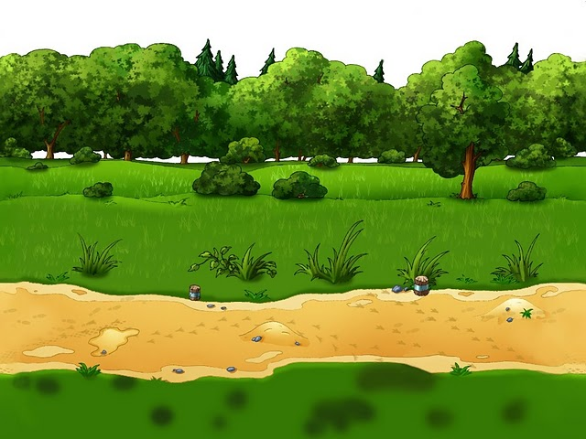
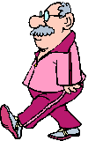

Mr. Smith, … wife is a nurse, goes to work on foot.
GREAT
which
who
whose

Slide 16

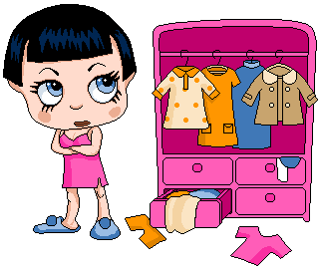

Daisy, … has a lot of clothes, never knows what to wear.
GREAT
which
who
whose

Slide 17

The girl… father is a teacher likes reading.
GREAT
which
who
whose

Slide 18
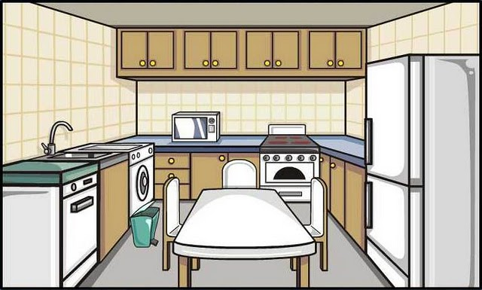
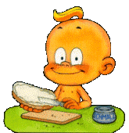
The boy … is having breakfast is my brother.
GREAT
which
who
whose

Slide 19
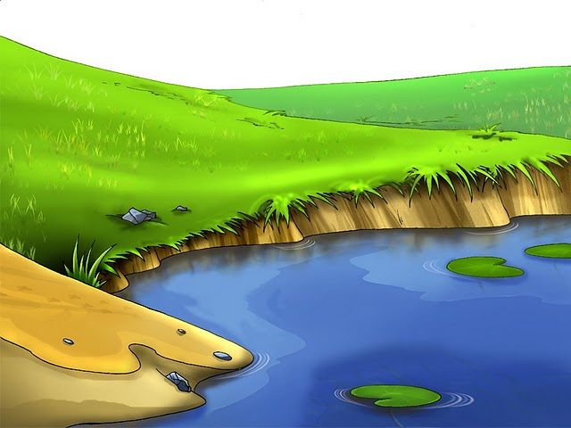
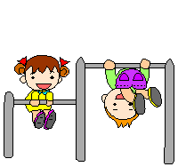

The man … children are playing is a farmer.
GREAT
which
who
whose

Slide 20
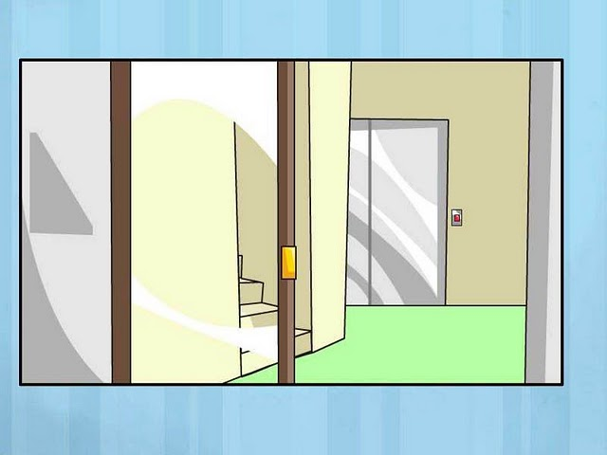

Lucy, … loves computers, is a bad student.
GREAT
which
who
whose

Slide 21
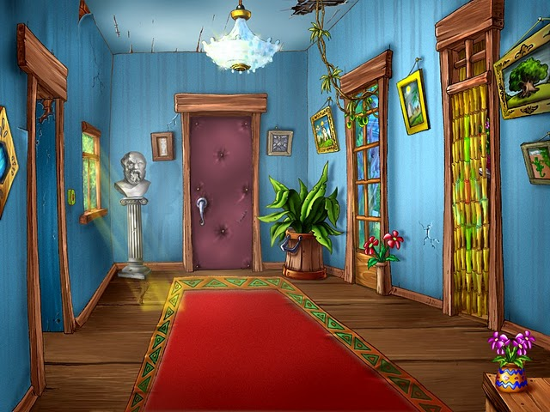

Marion, … brother is a singer, is a good student.
GREAT
which
who
whose

Slide 22
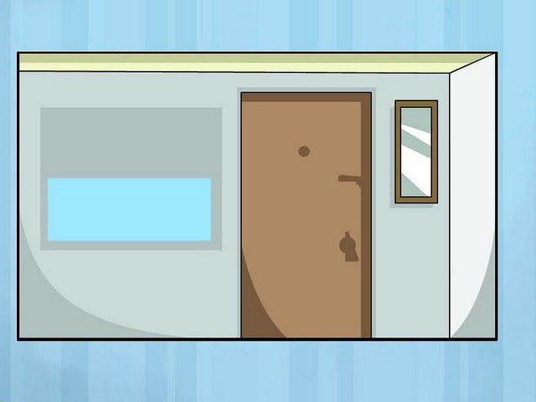

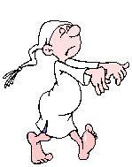
John, … is a sleepwalker, is nice.
GREAT
which
who
whose

Slide 23
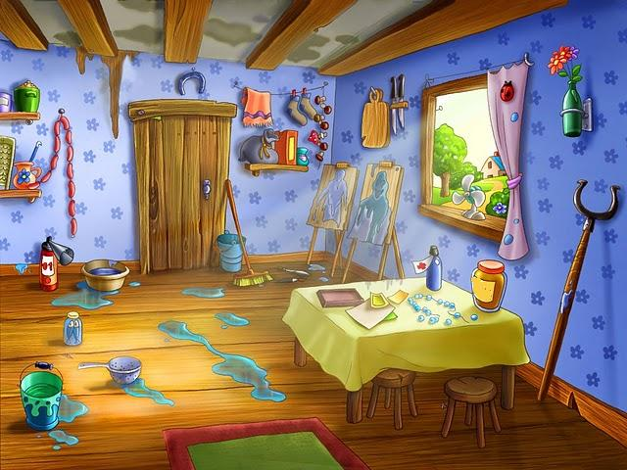
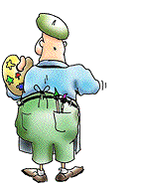
Van Gogh, … paintings are famous, didn’t have a studio like this.
GREAT
which
who
whose

Slide 24




THANK YOU VERY MUCH

